Slide 1
Saskatchewan Trapping Regulations
Humane Trapper Education Course

Slide 2
Remember!
You are responsible for knowing the laws that apply to what you are doing.
There are changes made to regulations annually.
Be sure to check your Trappers’ Guide or talk to a conservation officer if you are unsure.

Slide 3
Fur Harvest Management in Saskatchewan
Furbearer conservation including all aspects that relate to the harvest of furbearers are under provincial jurisdiction and is managed by the Saskatchewan Ministry of Environment.
For management purposes, the province is divided into North and South Fur Conservation Areas (NFCA and SFCA).
While many regulations apply provincially to both NFCA and SFCA, a number are specific to each so it is important to be aware what regulations are that apply to your area.

Slide 4
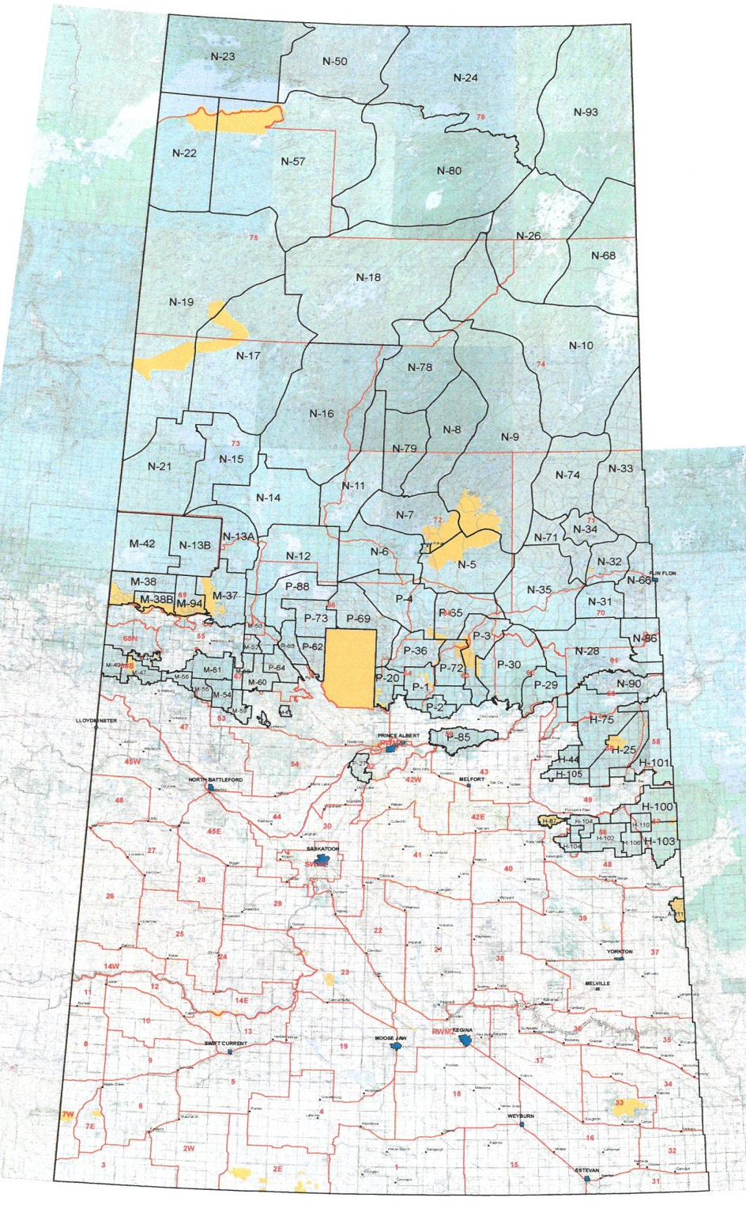

Slide 5
NFCA Special Areas
In addition to the formal NFCA blocks shown in green on the map, all vacant crown lands north of the line shown in bold blue on the map (see next slide) are considered special areas within the NFCA.
These special areas are open and do not require a trapper to be a member of a block.
All regulations applicable to the NFCA apply to these special areas.
Contact the local ministry office to obtain permission.

Slide 6
Southern Boundary of NFCA in Regulations

Slide 7
Definition of Trapping in Saskatchewan Regulations
Trapping is included under the definition of hunting in Saskatchewan such that, unless specifically exempted, the rules that pertain to hunting with firearms will also apply to shooting or trapping of furbearers under a trapping licence.

Slide 8
Do I Need a Licence to Trap?
You require a fur licence to harvest most furbearer species. Some species also require additional permits.
You do not require a licence to harvest coyotes with a firearm, to trap raccoons and skunks or to trap beaver in rural municipalities that have passed an open season bylaw.
However, regardless of the species, you need a fur licence if you wish to sell the pelt.

Slide 9
What Do I Need to Get My Licence?
You must be 12 years of age
You must have your firearms safety/hunter education certificate
You must have a valid Saskatchewan Wildlife Habitat Certificate
You must either take this course or pass a challenge exam

Slide 10
Where Do I Get My Licence?
SFCA licences are available online through the automated Hunting, Angling and Trapping Licencing System (HAL), through all vendors or any ministry office with front counter service.
NFCA and youth licences are only available a local ministry offices with front counter service.

Slide 11
How Long is My Fur Licence Valid?
Your fur licence is valid for the purposes of trapping until August 31 following the date of issue.

Slide 12
Where Can I Go Trapping?
In the NFCA, outside of the special areas, you must be voted in by members of the trapping block you are applying for and then you will be assigned a zone or area for your use.
In the SFCA, you can trap on any land provided you have the permission of the landowner. You need additional permission of the owner or occupant of any residence or livestock handling facility within 500 metres of your sets.
On crown lands, permission is required from the appropriate representative of the crown or the crown lease holder.

Slide 13
When Can I go Trapping?
Most of Saskatchewan furbearers are protected outside of specified season dates that are intended to cover the period when the fur is prime.
Season dates for all Saskatchewan species are shown annually in the Trappers’ Guide.
Some species such as coyotes, beaver (in designated rural municipalities only), raccoon and skunk can be harvested year-round but the pelt will be of little value outside of the colder months.

Slide 14
What If I Want to Hunt Fur Animals During an Open Big Game Season?
Provided they are not hunting with or aiding a big game hunter, a licenced trapper may hunt fur bearer animals other than cougar province-wide or black bear in the SFCA.
In the NFCA, a trapper who is conducting normal black bear trapping operations may use a firearm to harvest black bear. Normal black bear trapping operations means the trapper has several traps operation at one time and checks them in a planned and regular manner.

Slide 15
Are There Any Species-Specific Regulations I Should Know?
Coyotes can only be harvested without a licence if using a firearm – if trapping or snaring you must have a fur licence.
There is no ministry requirement to hold a fur licence when harvesting beaver in rural municipalities (RM) with open season regulations. However, most RM’s require that individuals turning in beaver for bounties must hold a fur licence. Be sure to check your RM.
There are minimum calibre requirements for big game species (ex black bear and wolf). Refer to Section 17 of The Wildlife Regulations, 1981 (link below) or consult a conservation officer.
http://publications.saskatchewan.ca/#/products/1602

Slide 16
Special Restrictions for Trapping Bear
Only mechanically activated foot snares are legal for the capture of black bear.
In the SFCA, firearms may only be used to dispatch a black bear already caught in a foot snare.

Slide 17
Special Restrictions for Trapping Cougar
Harvest of cougar is restricted to the use of traps and authorized snares only.
Firearms may only be used to dispatch an animal already caught in a trap or snare.
Trappers are required to immediately report harvested cougar to the ministry to receive a permit to possess or sell the animal.

Slide 18
Can I Carry a Firearm on an All-Terrain Vehicle or Snowmobile When I am Trapping?
During an open season for big game other than wolf, you may carry a .22 calibre (or less) rimfire rifle in a vehicle while conducting normal trapping operations. A vehicle includes all terrain vehicles (ATV) and snowmobiles.
Outside of a big game season, an unencased, unloaded firearm may be carried on an ATV or snowmobile.

Slide 19
Can I Use a Light When I am Trapping?
A person may use a searchlight for the purposes of conducting normal trapping operations.

Slide 20
Can I Use a Road-Killed Animal for Bait?
Yes, if to the best of your knowledge the wildlife was legally killed.
You must, within seven days of taking possession of the dead wildlife, provide the wildlife to a wildlife officer for inspection and apply for a free permit to posses the wildlife. To retain the skull or antlers you will need an additional permit.

Slide 21
Transport of Road-Killed Animals
Road-killed animals show a higher prevalence for diseases such as chronic wasting disease. For this reason, permit conditions require that the animals be used as bait within 80 kilometres of where they were obtained.
This is to reduce the risk of spreading diseases to new areas.

Slide 22
What Traps Can I Use?
It depends on what species you are targeting and whether you intend to use killing traps, restraining traps, live traps or snares.
Most Saskatchewan furbearer species are covered under the Agreement on International Humane Trapping Standards (AIHTS) which generally dictates the types of traps that can be used.

Slide 23
What is the Agreement on International Humane Trapping Standards – AIHTS?
The AIHTS is an agreement between the European, Russia and Canada that is intended to ensure that only the most humane traps available are used in capture of furbearers.
The most humane traps also give trappers their best return as kills are quicker and restrained animals suffer less injury.

Slide 24
AIHTS and the Fur Trade
This agreement is a benefit to trappers as it helps secure an open door to foreign markets and to address criticism of the industry at home.

Slide 25
What Determines if a Trap is Certified Under the AIHTS?
Killing Traps are certified based on meeting a required minimum average time between capture and time of unconsciousness (45 seconds for weasel; 2 minutes for marten; 5 minutes for all others).
Restraining traps are certified based on the amount and nature of injuries suffered by a captured animal.
All testing is conducted at a specialized facility at Vegreville, Alberta and tests must meet rigorous scientific standards.

Slide 26
How Do I Find Out What Traps I Need for the Animals I Am After?
The most up to date listing of certified traps is on the website of the Fur Institute of Canada (FIC).
www.fur.ca
This list is updated immediately as traps are added.

Slide 27
Are All Furbearers Covered Under the AIHTS?
No. Saskatchewan species not included under the AIHTS are red and arctic fox, mink, wolverine, red, gray and fox squirrels, least and long-tailed weasels and skunks.
Saskatchewan however has used provincial regulations to apply AIHTS standards to all fox and weasel species so really only mink, wolverine, squirrels and skunk are without standards in place or under consideration.

Slide 28
Is it Mandatory to Use Certified Traps for all Species Covered Under AIHTS?
Not necessarily. Some species have not yet had enough traps tested and certified. For these it is still legal to use any type of otherwise legal trap.
The FIC website also list those traps that have been certified for species where it is not yet mandatory to use certified traps. This list allows trappers to plan their trap purchases ahead of when certified traps become mandatory for those species.
Note that all restraining traps must be modified to meet humane standards even if there is no requirement to use certified restraining traps for a particular species.

Slide 29
How Can I Modify My Restraining Traps to Meet Humane Standards?
There are three acceptable ways to modify old style restraining traps to make them legal today:
  Offset the jaws so there is a minimum of five millimetres between the jaws when closed.
  Fasten manufactured pads of a rubber like substance to the trap jaws. Duct tape is not an acceptable substance.
  Add lamination to the trap jaws to increase jaw thickness to nine millimetres or greater.

Slide 30
Are There Any Other Restrictions on the Use of Traps That I Should Know?
You cannot use foot-hold traps for beaver, muskrat, otter, or mink unless the trap is set so the animal drowns when caught.
You cannot use foot-hold traps with an inside jaw opening more than 24 centimetres.
You cannot trap black bears except with mechanically activated foot snares.
You cannot use hooks or sharp devices to snag or spear furbearing animals.
You cannot use traps with serrate jaws or teeth to take furbearing animals.

Slide 31
Does the AIHTS Cover Snares?
No. Snares are currently not included under the AIHTS and are regulated provincially.

Slide 32
What Regulations Apply if I Want to Use Neck Snares?
Saskatchewan recognizes three main types of neck snares: power snares, power-assisted snares and free-hanging or common snares. There are important differences in the regulations that apply for the use of each.
Power snares are defined as mechanically activated such that the snare is closed by a spring with a leg or arm no less than 30 centimetres in length or by a lever and coil-spring system in which the spring is no less than 25 centimetres long.
Power-assisted snares require the use of specific components as described in policy and regulation.
Mechanically activated spring-loaded snares that do not meet these standards are considered as free-hanging snares for regulatory purposes.

Slide 33
What are the Regulations About Using Power Snares?
Power snares can be used throughout the province.
A permit from the ministry of environment is required and is available at no cost from a ministry office with front counter service.
Power snares can be used for all furbearers except black bear.

Slide 34
What are the Regulations About Using Power-Assisted Snares?
Power-assisted snares can be used throughout the province.
A combined power and power-assisted snare permit from the ministry of environment is required and is available at no cost from a ministry office with front counter service.
In the SFCA, power-assisted snares can only be used for coyote, bobcat, lynx and red fox.

Slide 35
Why Do I Need a Permit to Use Power and Power-Assisted Snares?
The regulations require that you obtain a permit because the permit contains a number of conditions in addition to what is identified in regulation.
These conditions help ensure that power snares are set in a manner that minimizes risks to people, pets and livestock.
These conditions are law and failure to comply with them could lead to charges being laid and to loss of permit rights.

Slide 36
What Are These Conditions?
The most significant conditions are as follows:
  The permit describes the break-away standards required to help reduce incidental capture of wildlife and livestock.
  The break-away standard is the maximum allowable pressure that the snare will hold before it breaks away. The standard then determines what snare cable width can be used depending on whether additional safeguards are in place such as a pressure sensitive S-hook.
  The permit also requires that in addition to getting the permission of occupants within 500 metres of a snare set, the permittee must also notify any additional landowners within 1.6 kilometres of the set.
  Power-assisted snares must have must have a legible identification tag with the trapper’s HAL ID or name/phone number.

Slide 37
What Are the Regulations For Free-Hanging Snares?
All free-hanging snares must be equipped with a locking device.
Free-hanging snares are not allowed for general fur harvest in the SFCA.
A permit from the ministry is required for their use and in the SFCA will only be issued to individuals who are resolving an active livestock predation complaint.

Slide 38
How Often Do I Need to Check My Traps?
Within 5 kilometres of a town with 1000 or more people in the SFCA you must check your traps every 24 hours.
Anywhere else in the SFCA you must check your traps every 72 hours.
In the NFCA, you must check your traps every 120 hours.

Slide 39
What Do I Do if I Harvest an Animal That is Not Legal For Me to Trap?
Every effort should be made to set your traps in a manner that will target the species you are after and exclude or discourage other species.
Inevitably however, you will occasionally catch species which you cannot legally trap or can’t trap at that time of year.
It is mandatory that you report these incidental captures immediately to the nearest conservation officer.

Slide 40
Can Someone Else Trap Where I Am Trapping?
In the SFCA, it is permissible to trap wherever you have permission and if more than one person has permission they can trap near you.
It is illegal to touch or interfere with any legally placed traps or snares, unless authorized by the owner to do so.

Slide 41
As a Licenced Trapper, Can I Harvest Fur Animals Using Just a Firearm?
Firstly, you must be in lawful possession of a firearm. If you are under the age of eighteen, you must obtain a federal minor’s permit to posses a firearm.
You can utilize a firearm to harvest fur animals, except cougar province-wide and black bear in the SFCA, however you are still subject to all regulations governing the use of a firearm for hunting as indicated in The Wildlife Act and/or The Wildlife Regulations.
You cannot shoot or attempt to shoot any beaver in the SFCA on any land without the permission of the owner or occupant of the land.

Slide 42
Is There Anything I Should Know When I Finish Trapping For the Season?
Pick up all your traps and snares!
It is illegal to leave a trap or snare set for a fur animal following the close of the open season for that animal.
Even if trapping a species with an open season, such as coyotes, don’t leave traps or snares out after you are done trapping. This can lead to accidental captures of livestock and pets which puts all trappers in a bad light.

Slide 43
Can I Buy Fur From Another Trapper and Sell Them With Mine?
Yes, but you will need to purchase a fur dealers licence.
If you are the holder of a fur licence, you will also need a special permit to hold both licences.
The fur dealers licence costs $60.00 and the permit is free. Application forms are available at Saskatchewan.ca.

Slide 44
Can I Export My Fur or Take Them to Another Province?
Yes. A fur export permit is required when exporting fur or taking them out of province.
The fur export permit can be acquired at a ministry field office with front counter service.

Slide 45
Can I Keep Fur for My Own Use?
Yes. Simply retain a copy of your licence as verification the furs were legally taken.

Slide 46
So Is This All I Need to Know About the Rules?
No! Just the main ones!
A complete list of the regulations that pertain to trapping can be obtained online: http://www.publications.gov.sk.ca/details.cfm?p=1602
If in doubt, contact a conservation officer. Remember that ignorance of the law is not an acceptable excuse when an infraction is committed.

Slide 47
A Safety Reminder
Furbearer species are known to carry a variety of diseases including rabies, canine distemper, tularemia, tapeworm and ringworm.
They are also carriers of mites and fleas that can be an irritant to humans.
It is always advisable to wear gloves when processing animals and to wash thoroughly after handling.

Slide 48
How Can Trappers Contribute to Furbearer Conservation?
Report unusual species occurrences to the ministry.
Turn in possibly diseased animals to the ministry or the Canadian Cooperative Wildlife Health Centre at the Western College of Veterinary Medicine in Saskatoon.
Complete the annual status of furbearer survey available through the HAL website.

Slide 49
Questions?

Slide 50


